Slide 1
From Image Captioning to Visual Storytelling
11-11-2024
MSc Thesis Presentation
Admitos Rafail Passadakis

Slide 2
Contents
11-11-2024
Introduction
Related Work
Methods
Experimental Set-up
Results
Conclusion
Comparisons & My Story

Slide 3
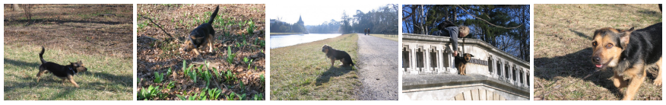
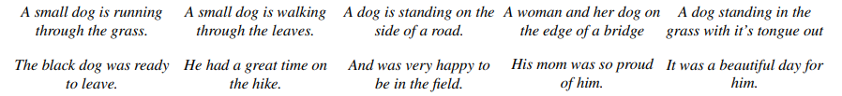
Introduction
11-11-2024
OUR TASKS:
Image Captioning (IC): Creating mere descriptions of the depicted elements in the images which can be in isolation (they can be visually uncorrelated).
Visual Storytelling (VS): Conveying a narrative through a sequence of images (can be visually correlated) with the goal of telling a story, capturing the contextual relationship among the events or characters in the images.
Captions:
Story:

Slide 4

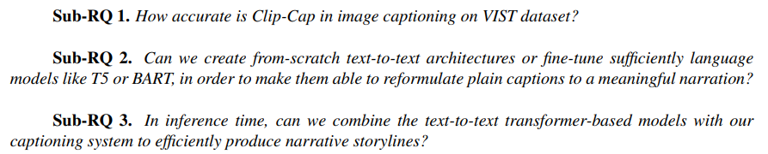
Introduction
11-11-2024
RESEARCH QUESTIONS:
Previous Approaches: VS and IC are two distinct tasks.
Our Approach/Motivation: Can we work altogether on those tasks by considering IC as subset of VS? (i.e. using the central information/meaning of captions so to create the story)
But by breaking it down …
Notes:
1) Data: Usage of the Visual Storytelling (VIST) Dataset. (More in a while…), 2) Models: Transformer-based language models (Clip-Cap, T5 etc.) (More in a while…)
3) Evaluation procedures: Automatic, Human & Artificial Evaluation. (More in a while…)

Slide 5
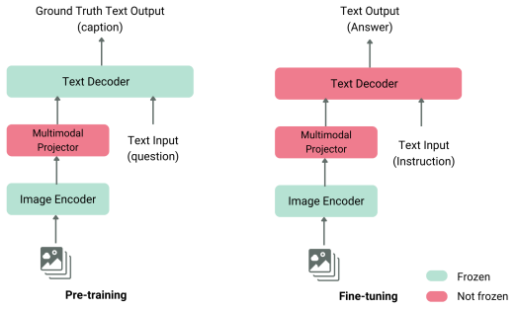
Related Work
11-11-2024
VISION & LANGUAGE
Vision & Language Tasks: Visual Question Answering, Image Captioning, Video Captioning, Visual Storytelling.
Image Captioning (2014): Roots on MSCOCO dataset by Microsoft. Not only Image classification or object recognition but aimed for understanding the broader context of the scene.
Vision & Language Models: Generative models, such as Transformers, that receive visual and textual inputs and generate text outputs. Multimodal Projector: Aligns image and text representations.

Slide 6
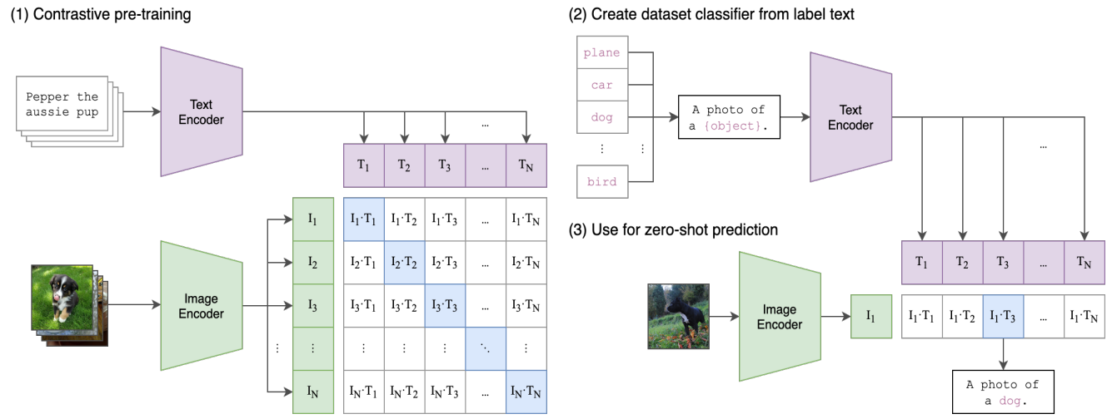
Related Work
11-11-2024
A FAMOUS V&L MODEL
CLIP (Contrastive Language-Image Pretraining - Radford et al.): A V&L model that is trained using contrastive learning, proposed by OPENAI. It is designed for understanding how well images and text (captions) fit together.
During training: CLIP attempts to maximize the cosine similarity between correct pairs of (image-captions) and to minimize the cosine similarity of incorrect pairs.
During inference: CLIP calculates the similarity scores between the vector of a single image with some possible caption vectors and gives a probability distribution indicating the most favorite caption (the one with the highest similarity).
CLIP is NOT a captioning model.

Slide 7
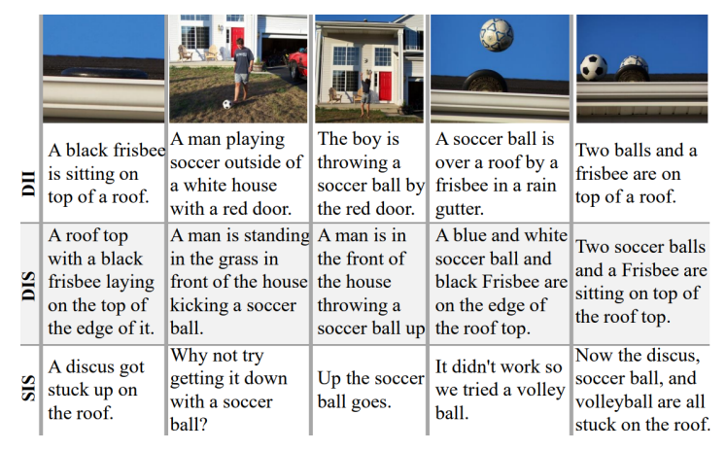
Related Work
11-11-2024
DATASET
Visual Storytelling (2016) : Roots on VIsual STorytelling (VIST) dataset by Huang et al.
Three tiers: Descriptions of images-in-isolation (DII); Descriptions of images-in-sequence (DIS); Stories for images-in-sequence (SIS).
For Captioning we use DII, for Storytelling we use SIS.
Visual Storytelling is significantly different task than Image captioning.

Slide 8
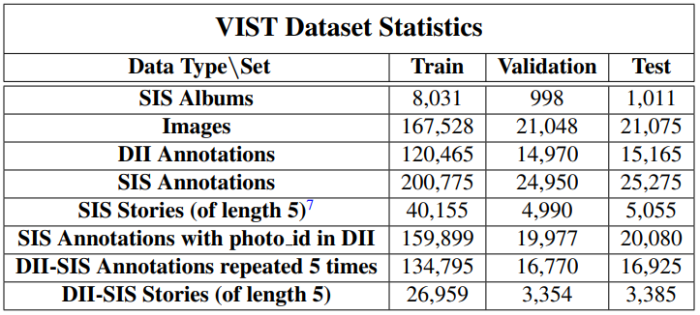
Related Work
11-11-2024
DATASET
Dataset Statistics
SIS > DII (Same images in many different stories) → For story generation we focused on the part of SIS that is also present on the DII.

Slide 9
Related Work
11-11-2024
HONOURABLE MENTIONS
GLAC-Net: Glocal attention cascading networks for story generation (Kim et al.):
CNN feature extractor, LSTM generators.
  Two types of Attention: Local (image feature level) & Global (the overall storyline encoding level).
  Cascading: During generation, the hidden state (context) of the previous sentence is conveyed to the next sentence through the LSTM’s recurrency.
AREL: Adversarial reward learning for visual storytelling (Wang et al.):
Limitations of conventional metrics (BLEU, METEOR). AREL framework includes:
  Policy model: Given an image sequence, attempts to form a narrative story.
  Reward model: Is optimized adversarially and aims to bring the prediction closer to human annotations.

Slide 10
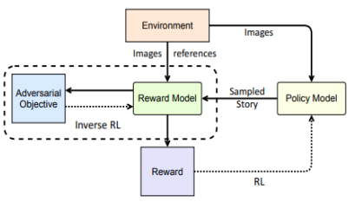
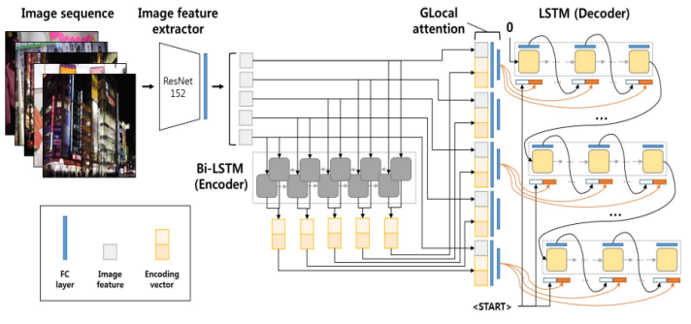
Related Work
11-11-2024
HONOURABLE MENTIONS
AREL
GLAC-Net

Slide 11
Related Work
11-11-2024
HONOURABLE MENTIONS
KG-Story: Knowledge-Enriched Visual Storytelling (Hsu et al.):
A three-stage framework that combines Transformer architecture with Knowledge Graphs.
  Distill: The prompted images are refined to word-terms to get descriptive representations.
  Enrich: The word-terms are enriched to a linked conceptual path using external graphs.
  Generate: A transformer with positional encoding converts the conceptual paths to stories.
MCSM+BART: Commonsense Knowledge Aware Concept Selection for Visual Storytelling (Chen et al.):
Extract relative concepts from the image sequences → Utilize a large scale pretrained model (BART) to convert concepts and images into full stories (after fine-tuning).
  Obtain image features using CNN visual encoder → Extract image concepts using deletion & ConceptNet.
  Build a commonsense knowledge graph for each image concept by using a Graph Attention Network.
  Concept selection using Maximal Clique Selection Module (MCSM): For all possible concept pairs, a correlation map is constructed on which pruning of the edges takes place based on a threshold. The pruning leaves a maximal clique (fully – connected graph) which is given to BART along with the image feature for generation.

Slide 12
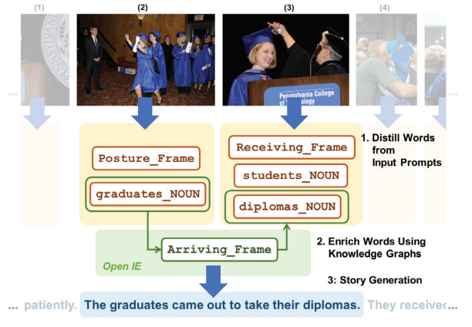
Related Work
11-11-2024
HONOURABLE MENTIONS
KG - Story

Slide 13
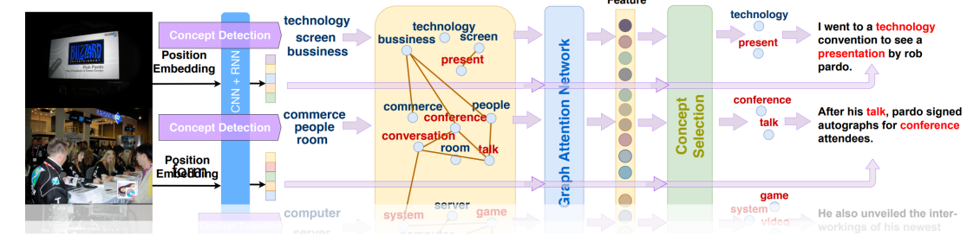
Related Work
11-11-2024
HONOURABLE MENTIONS
MCSM + BART

Slide 14
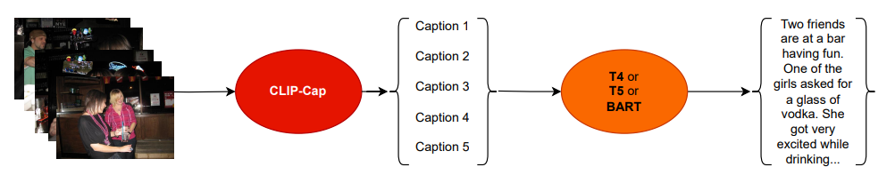
Methods
11-11-2024
OVERALL FRAMEWORK
Image-to-caption model: Clip-Cap
  Generates captions for the series of images in the input.
Caption-to-story model: T4 or T5 or BART
  Reformulate the mere captions to a narrative story.

Slide 15
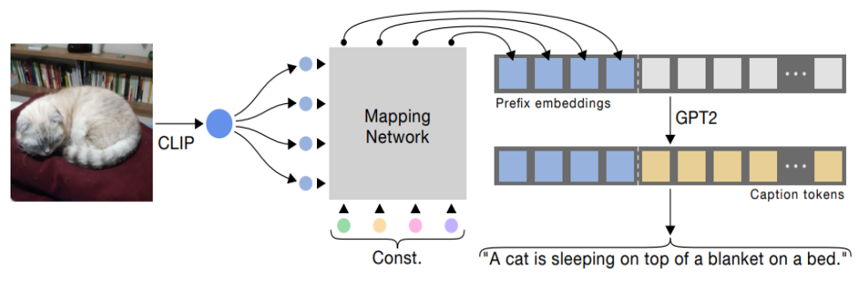
Methods
11-11-2024
IMAGE-to-CAPTION MODEL
Clip-Cap (Mokady et al.): Uses the encoded CLIP output as a prefix to the caption.
Clip-Cap consists of three parts: 1) CLIP, 2) Mapping Network and 3) Language generator (GPT-2).
It was fine-tuned and evaluated on three datasets: 1) MSCOCO, 2)Conceptual captions and 3) Nocaps.
Mapping Network:
  Transformer: Only the Mapping network is fine-tuned → Clip-Cap is extremely lightweight.
  MLP: In that case GPT-2 is fine-tuned as well → Clip-Cap moderately heavier but still okay.

Slide 16
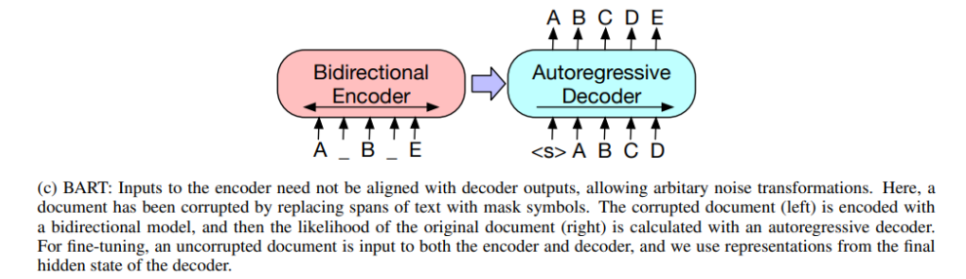
Methods
11-11-2024
CAPTION-to-STORY MODEL
BART (Bidirectional Auto-Regressive Transformer - Lewis et al.): A denoising autoencoder transformer that maps a corrupted document back to the original document.
Pre-trained Using Document Corruption Techniques: Token Masking, Token Deletion, Document Rotation, Sentence Permutation and Text Infilling.
It combines BERT-like Encoders & GPT-like Decoders → Can be used for both understanding and generation tasks.
Notes:
After the pre-training steps, the decoder learns to reconstruct the corrupted encoded input back to the original text.

Slide 17
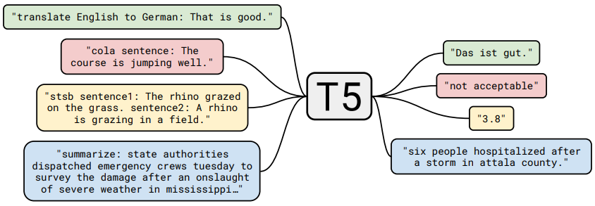
Methods
11-11-2024
CAPTION-to-STORY MODEL
T5 (Text-to-Text Transfer Transformer - Lewis et al.): Follows the original transformer. Can handle a wide range of NLP tasks by converting them into text-to-text format and without change in its architecture.
The conversion to text-to-text format is done by using prefixes in the original input by indicating the task.
Pre-trained Using Document Corruption Techniques: Span Corruption, Token Deletion, Sentence Shuffling.
Also combines BERT-like Encoders & GPT-like Decoders → Can be used for both understanding and generation tasks.
Notes:
T5 learns both broad and local context representations by focusing on token-level relations and sequence-level order.

Slide 18
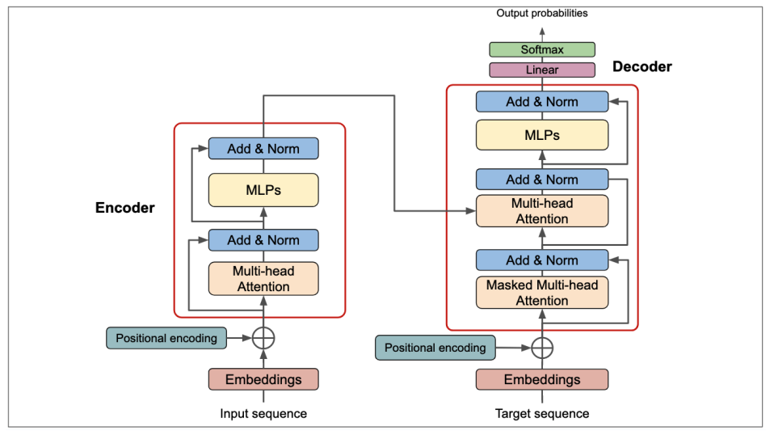
Methods
11-11-2024
SELF MADE T4 TRANSFORMER
T4: Our from-scratch architecture → Follows the original Encoder-Decoder transformer.
Another Text-to-Text Transformer. (Small?) imitation of the T5 and BART models.

Slide 19
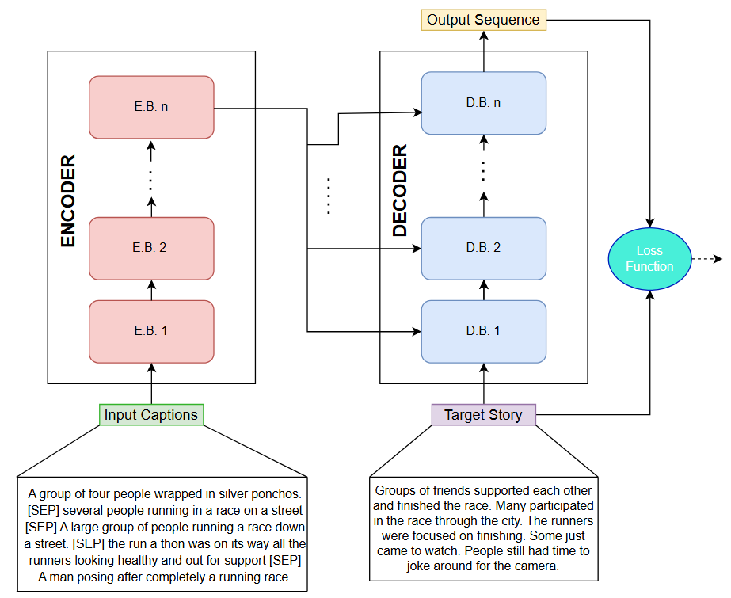
Methods
11-11-2024
HOW DO WE FINE-TUNE?
Direct Sequence-to-Sequence Training/Fine-tuning:
Passing the input sequence (captions) and the target sequence (story) to the model at every batch iteration.
The output sequence has size (batch_size, |Y|, |V|).
The loss function is Cross Entropy.

Slide 20
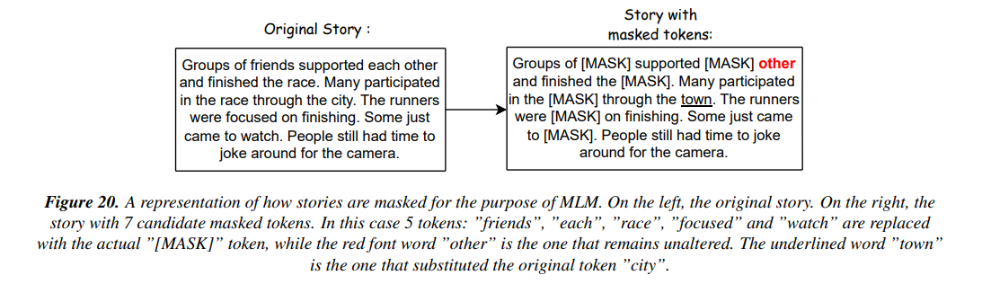
Methods
11-11-2024
CORRUPTING OUR T4
MASK LANGUAGE MODELLING (MLM):
  A percentage of input tokens is masked at random → The model is trained to predict these tokens.
  Most fundamental method of document corruption. Its bidirectional nature empowers the local contextual understanding of the model and increases its robustness and generalization abilities.
  Attempt to be adapted to our Visual Storytelling setting.

Slide 21
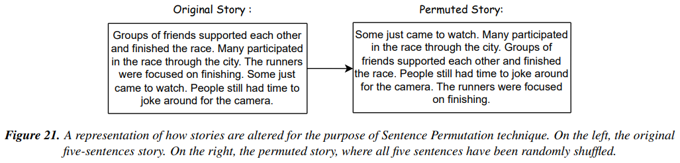
Methods
11-11-2024
CORRUPTING OUR T4
SENTENCE PERMUTATION (SP):
  Sentences within a document are shuffled randomly.
  It also enhances the contextual understanding of the model, especially the long-range dependences that potentially can occur between two or more sentences that are further away →Increases the versatility of models making them adaptable to various NLP tasks.
  Attempt to be adapted to our Visual Storytelling setting, as well.

Slide 22
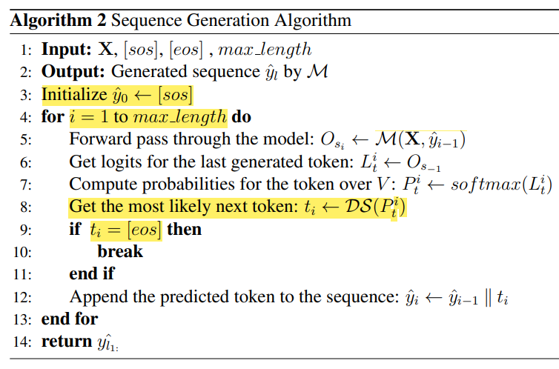
Methods
11-11-2024
IS T4 ABLE TO SPEAK?
Autoregressive Generation
Decoding Strategies
Greedy Search
Multinomial Sampling
Nucleus or P-sampling
Beam Search
Notes:
Multinomial sampling: A random roll

Slide 23
Methods
11-11-2024
EVALUATION PROCEDURES
→ Automatic Evaluation Metrics:
  BLEU: Measures co-occurrences of exact n-grams between the candidate and reference sentences.
  METEOR: Find similarity between a candidate sentence and reference sentences, including exact matches, synonyms, stemmed words etc.
  ROUGE_L: Computes the F-measure (Precision & Recall) based on the Longest Common Sub-sequence between the candidate and reference sentences.
  CIDEr: Measures consensus between candidate and reference sentences by performing a TF-IDF weighting for each n-gram.
  SPICE: A Dependency Parser creates a scene graph for the words for both the candidate and reference sentences establishing also semantic relations between the words.
  SPIDER: A Linear combination of SPICE & CIDEr.
→ Human Evaluation:
  According to Criteria: 1)Relevance with the Input Images, 2) Coherence & Flow, 3) Narrative Depth, 4) Imagination & Creativity, 5) Engagement & Interest, 6) Language & Style.
  Guessing: Guess among the five-given stories
  (4 machine, 1 human) which is the human written.
→ Artificial Evaluation with an LLM:
  Recruiting GPT-4o to judge the transition between the generated sentences in terms of coherence, temporal continuity and logical flow.
Notes:
Clipped Precision=Total clipped bigram matches​/Total candidate bigrams (for BLEU)
Precision​ measures the fraction of matched words in the candidate that appear in the reference.
Recall measures the fraction of matched words in the reference that appear in the candidate.

Slide 24
Experimental Set-up
11-11-2024
AN ARMY OF MODELS
  Following the sub-research questions → Separate the experiments in 3 Phases
  Phase 1 → Train/Fine-tune and test different variants of Clip-Cap on VIST images → Only Automatic Evaluation.
  Phase 2 → Train/Fine-tune and test different variants of text-to-text LMs (T4, T5, BART) on VIST DII captions → Only Automatic Evaluation.
  Ultimate Phase → Use the whole framework with the best fine-tuned models from the previous 2 phases for Visual Storytelling, only for inference time (no training/fine-tuning) → All types of evaluation processes.
Phase 1:
Three families of models (Clip-Cap variants):
  Zero-shot models from MSCOCO (4 in total).
  Models taken from MSCOCO & fine-tuned on VIST (8 in total).
  From-scratch models trained solely on VIST. (16 in total)
Phase 2:
Four families of models (but three types):
  T4 only trained with sequence-to-sequence on VIST/DII-SIS(4 in total).
  T4 pre-trained with MLM & SP and then seq-to-seq on VIST/DII-SIS (4 in total).
  T5 fine-tuned (seq-to-seq) on VIST/DII-SIS (3 in total).
  BART fine-tuned (seq-to-seq) on VIST/DII-SIS . (3 in total)

Slide 25
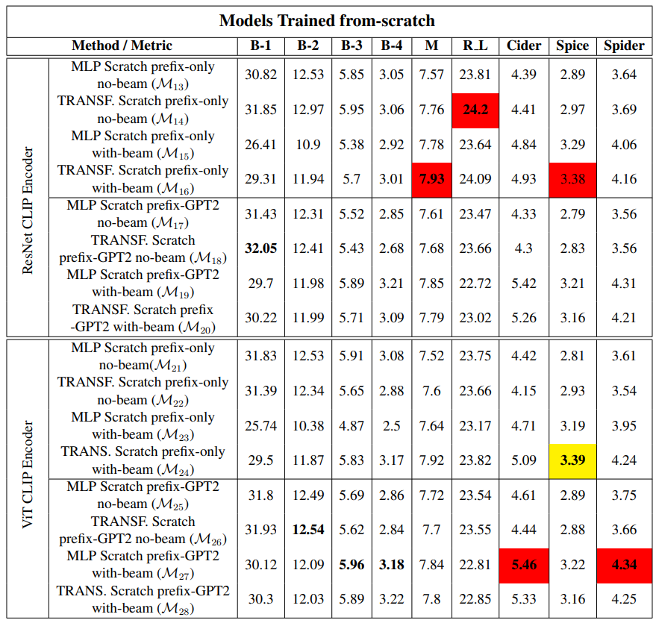
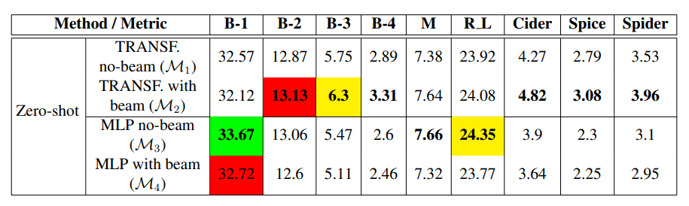
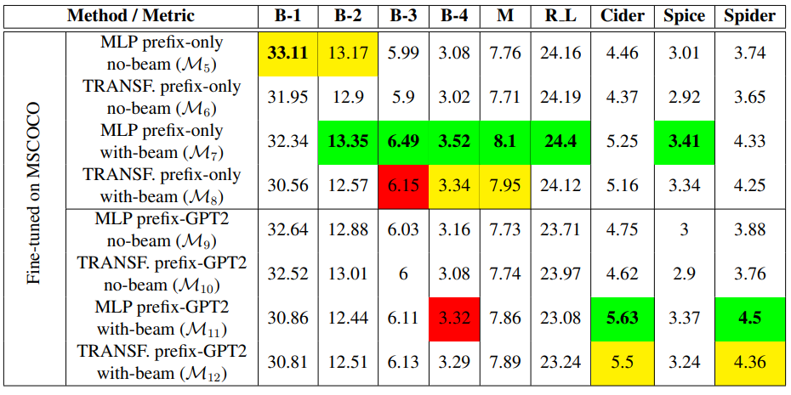
Results
11-11-2024
PHASE 1

Slide 26
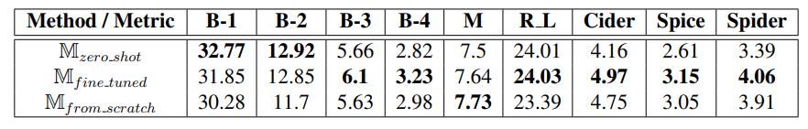
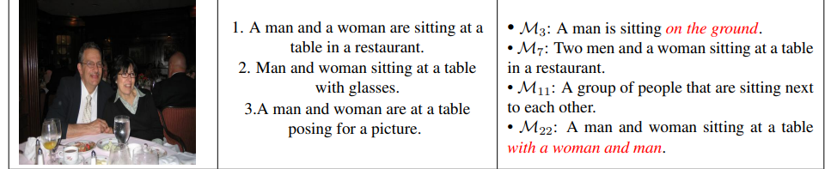
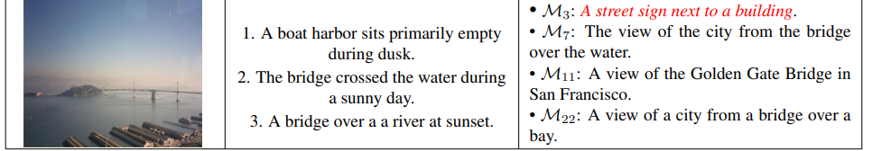
Results
11-11-2024
PHASE 1
Fine tuned models perform better on most metrics which essentially makes sense since they are doubly trained.

Slide 27
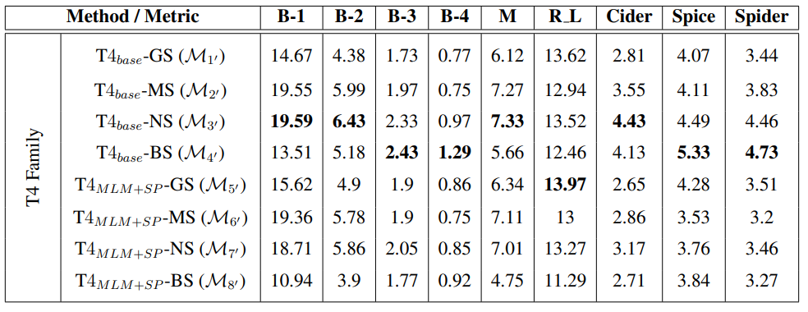
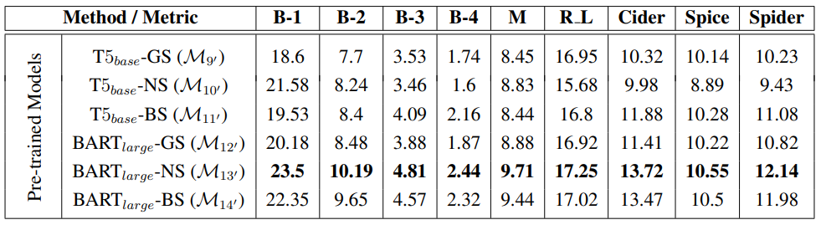
Results
11-11-2024
PHASE 2
BART models seem to perform better according to automatic metrics, but BART is … large.
Notes:
But… BART is two times larger than T5 and almost six times larger than T4.

Slide 28
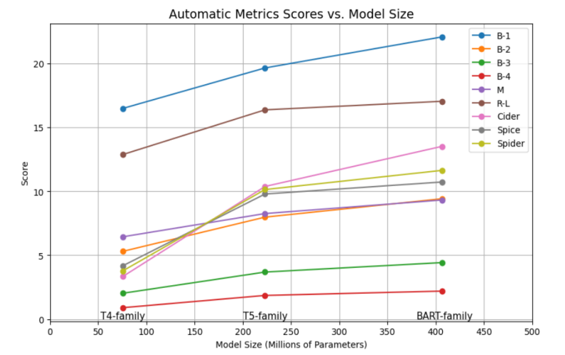
Results
11-11-2024
PHASE 2
Average results for all metrics per family of LMs.
As a result, the efficiency on automatic metrics is proportional to the size (in terms of trainable params) of the LM.

Slide 29
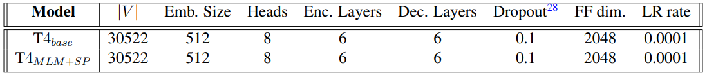
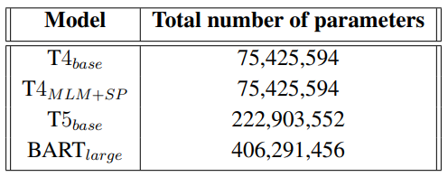
Results
11-11-2024
PHASE 2

Slide 30
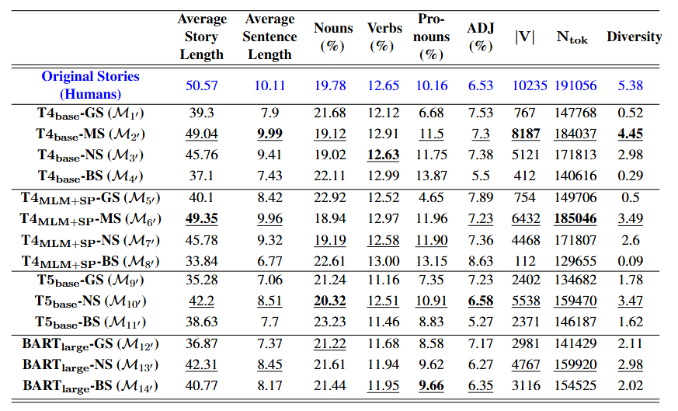


Results
11-11-2024
DID WE ACTUALLY LOSE?
According to many linguistically related metrics T4 models surpass T5 and BART (sometimes even on the same strategy) → Indication for more diverse sentences (stories), although depends on the strategy as well.
We propose the metric/tool of Ideality.
Ideality essentially measures how far are certain (lexical) characteristics of our machine generated stories, from the respective traits of some golden (human written) stories.
Notes:
Diversity = |V| / N_tok

Slide 31
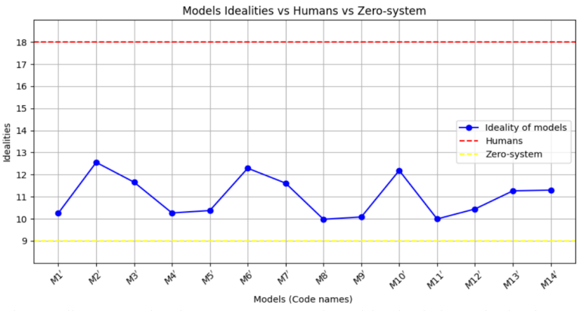
Results
11-11-2024
DID WE ACTUALLY LOSE?
T4 models
T5 & BART models

Slide 32
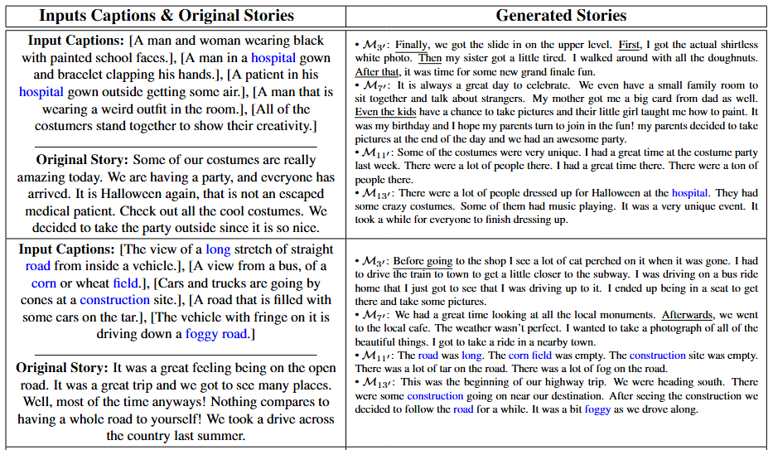
Results
11-11-2024
EXAMPLES PHASE 2

Slide 33
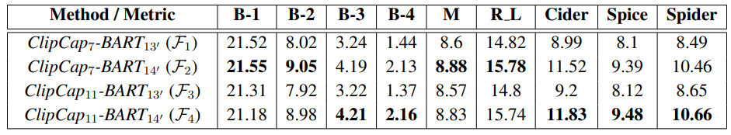
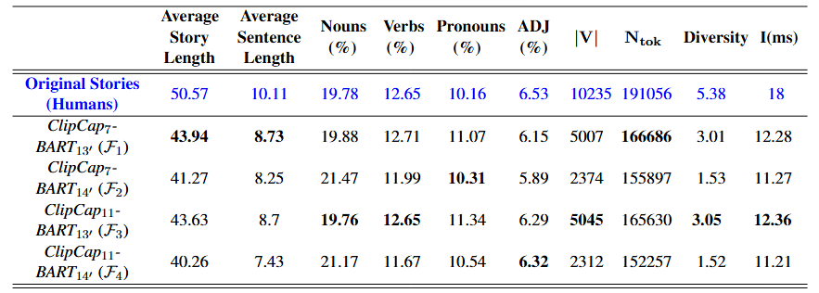
Results
11-11-2024
ULTIMATE PHASE
Two best captioners, two best storytellers → 4 combinations.
Frameworks F2 & F4 with BART 14’ (beam search) > Frameworks F1 & F3 with BART 13’ (p-sampling).
However, BART 13’ models accomplish higher scores of ideality, diversity → Greater variety of words and longer sentences are generated by these models → Indication for richer language.
Notes:
Keep the ideality and diversity scores of F3 and correlate them with the ranks the get from Humans in I, E and L

Slide 34
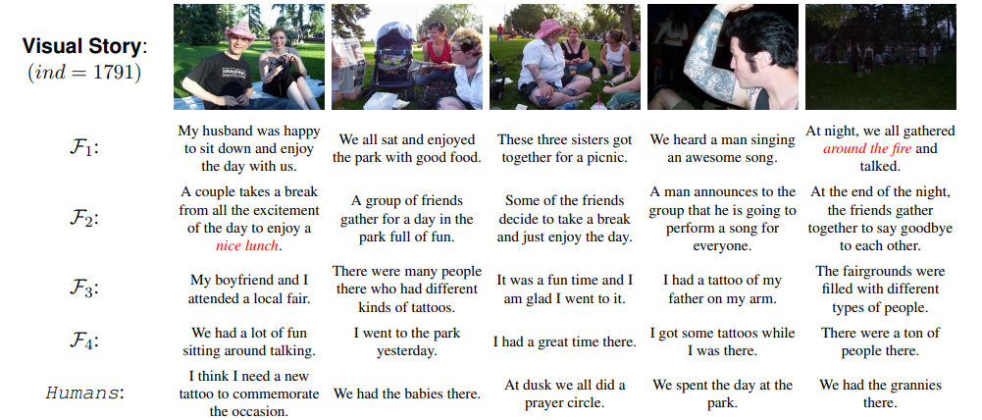
Results
11-11-2024
EXAMPLES ULTIMATE PHASE

Slide 35
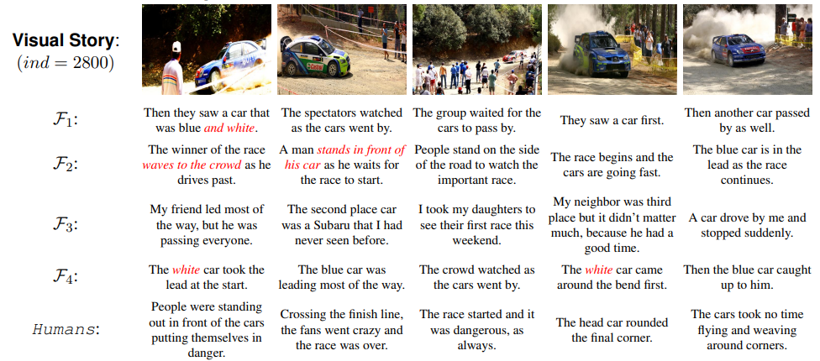
Results
11-11-2024
EXAMPLES ULTIMATE PHASE

Slide 36
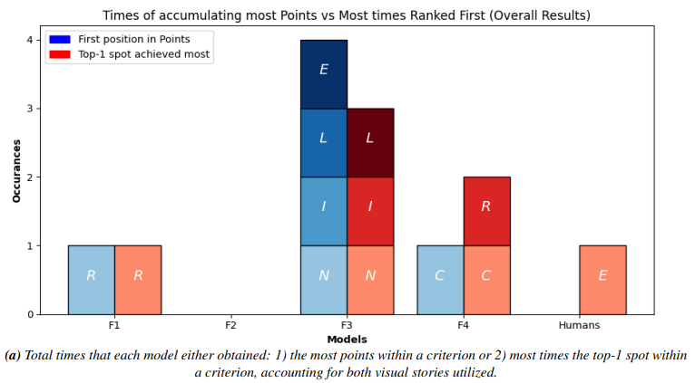
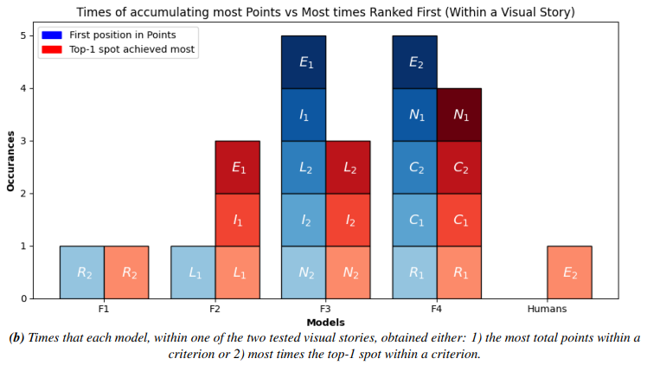
Results
11-11-2024
HUMAN EVALUATION ON CRITERIA
Rank the generated stories according to criteria. Based on the models’ position we give points.
Per framework we care about: 1) the total sum of gathered points, 2) the number of times it got the first position.
25 participants & each criterion was evaluated upon 2 different visual stories →50 ranks per criterion.
Overall: F3 dominates mainly because it gets the most points (& top-1 spots) in I, E and L.
Within stories: F3 & F4 are both very well. F4 prevails regarding R and C, while N is in between.

Slide 37
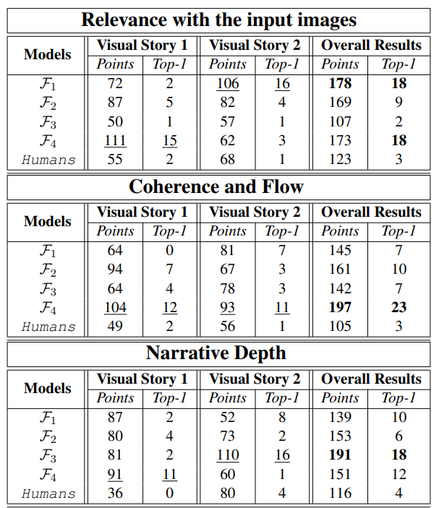
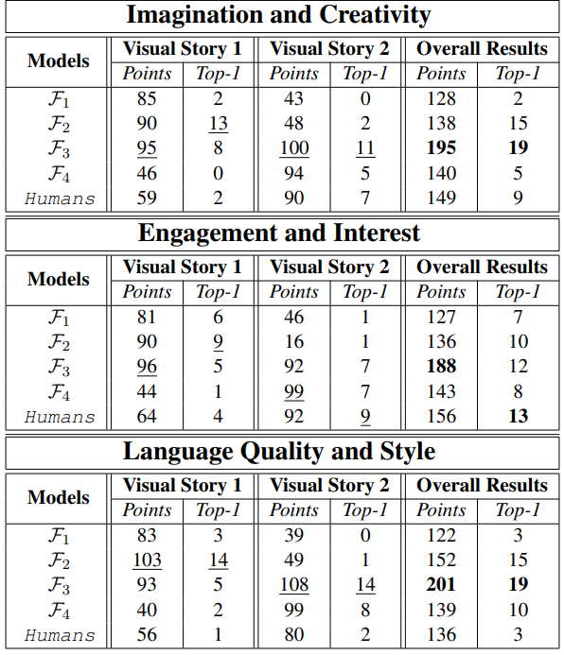
Results
11-11-2024
HUMAN EVALUATION ON CRITERIA

Slide 38
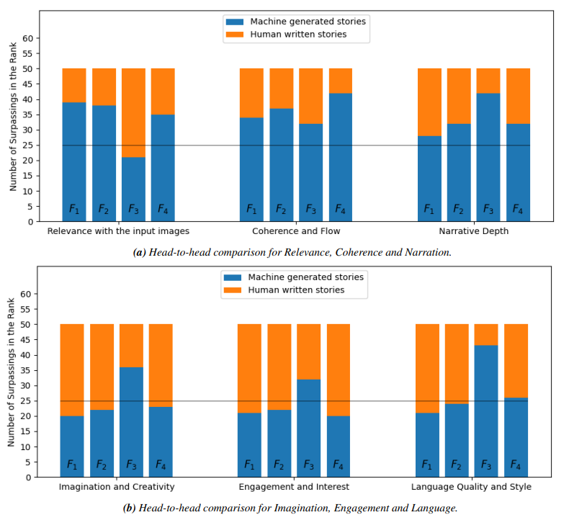
Results
11-11-2024
HUMANS VS MACHINES
Here we care about the number of times that a machine generated story by any framework was placed above the respective human stories.
We have 50 ranks → Majority is > 25.
On simpler criteria (R, C), our models outperform the human stories.
In more abstract terms such as I & E humans deliver better possibly because the L is better → engages more the annotators.

Slide 39
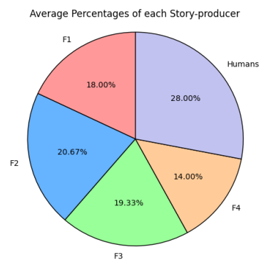
Results
11-11-2024
HUMANS VS MACHINES
Among the five given storylines, find the (one) human written.
Indeed, on average the participants guessed the actual human story as the
one that was not machine generated.
Still weak majority → Lot of uncertainty of what is human written/not.

Slide 40
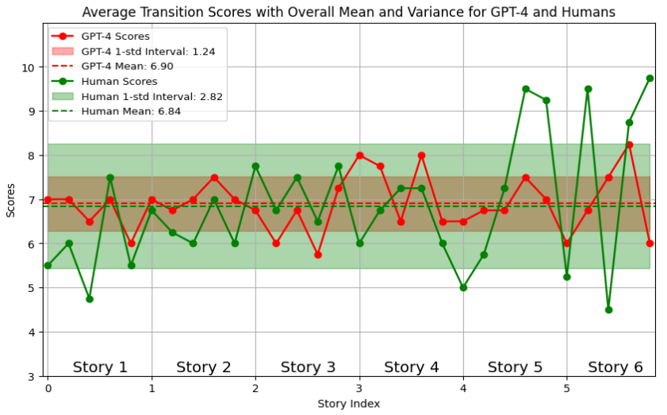
Results
11-11-2024
HUMANS VS (STRONG) MACHINES
  We asked GPT-4o to judge the transition between the generated sentences in terms of coherence and logical flow giving a mark from 1 to 10.
  Recruiting two workers to do the precisely the same for cross-validating the results.
  Both kinds of evaluation agree
  on average scores.
  Some similar grading patterns can be discerned.
  Human scores maintain much greater variance → Although depends on the evaluator.

Slide 41
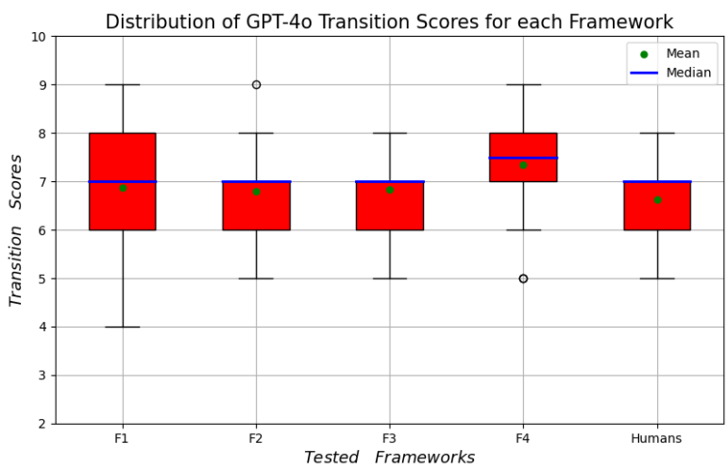
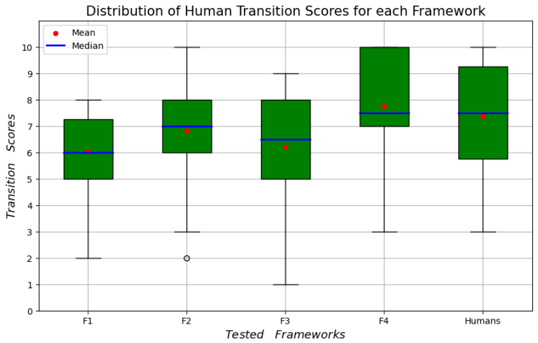
Results
11-11-2024
HUMANS VS (STRONG) MACHINES
Per Model Comparison between Human & GPT-4o judgment → Both agree that F4 produced the most coherent stories, while F1 and F3 the least coherent ones.

Slide 42
Conclusions
11-11-2024
MAIN TAKEAWAYS & LIMITATIONS
Per (sub)-research question:
Sub-Q1: Fine-tuned Clip-Cap models are quite accurate on VIST dataset for captioning.
Sub-Q2a: Unfortunately, T5 & BART > T4 in terms of automatic evaluation. However, the are immensely more pretrained and much more capacious in terms of parameters.
Out of the box: In terms of general lexical traits, T4 is matching against T5 & BART and obtains greater diversity and ideality on some occasions.
Problem of T4: It loses correspondence with its input (in this case the captions).
Sub-Q2b: Undoubtedly, BART & T5 can be fine-tuned appropriately for the task of storytelling, maintaining high attention to the input and delivering diversity as well.
Sub-Q3: All evaluation procedures showed that our proposed framework is capable of visual storytelling.
Best framework?:
  1) Both automatic & human evaluations showed that F4 is particularly strong.
  Nevertheless, it depends on the criteria we look upon (F3 is also strong).
  2) LLM and human evaluation showed that F4 produces more cohesive stories.
Humans vs Machines: Our stories pose a serious challenge for recognizing which story is human written or not, especially regarding R, C and N → We are approaching the human baseline for VIST dataset.
HOWEVER…, due to the moderate quality of human stories in VIST, we can’t claim that our framework is on general human level of storytelling
Notes:
Sub-Q2c: MLM & SP didn’t seem to help majorly our T4 models → Indication for further research. Possibly exposing both parts of the model (Encoder/Decoder) and separately.
Automatic evaluation associates better with R, C criteria.

Slide 43
Conclusions
11-11-2024
EXPANSIONS
Our proposed framework is not trained end-to-end → It’s promising to unify the model and subject it to
fine-tuning under a common loss.
Changing the way that we exploit the captions → Instead of “Serialization”, we could use “Parallelization” along with the image features.
Serialization:
Parallelization:

Slide 44


Loss Functions
11-11-2024
Cross-Entropy Loss: For each token in the sequence, the model gives a probability distribution over the vocabulary , at each time step. Cross-entropy measures the difference between the predicted distribution and the encoded form of the ground truth token. It penalizes incorrect predictions and encourages the model to maximize the probability of the correct token.
Contrastive Loss: It promotes the model to learn similarities between input pairs (images - sentences), by attempting to bring semantically related pairs closer, by mapping them in a new embedding space, while pushing unrelated pairs farther apart. Similar pairs are positive samples while the dissimilar ones are negative pairs. Contrastive Learning is a self-supervised learning method (because the model learns by itself to differentiate these pairs).
If is the fixed input, is a positive sample , is a negative sample, and are the distances between the representations of & and & and parameter to ensure that negative pairs are sufficiently farther away, we can express contrastive loss:
RL-based Loss: The Self-Critical Sequence Training (SCST) technique → The model generates two kind of sequences, a sampled and a greedy sequence. The sampled is a sequence stochastically created from the final probability distribution of the model over V, whereas the greedy is a sequence generated using greedy decoding. The reward is a score computed using a task-specific metric and it measures how well the sampled and the greedy sequence match the ground truth. In each generation step, the reward for the sampled sequence is compared to the reward of the greedy sequence which initially serves as the baseline.
Notes:
The parameter λ indicates if we have positive or negative pairs.
y_hat is the stochastically sampled sequence, with y_hat_greedy is the greedy sequence, r(ˆy) is the reward for the stochastically sampled sequence and r(ˆygreedy) is the reward for the greedy sequence which is set as baseline.

Slide 45
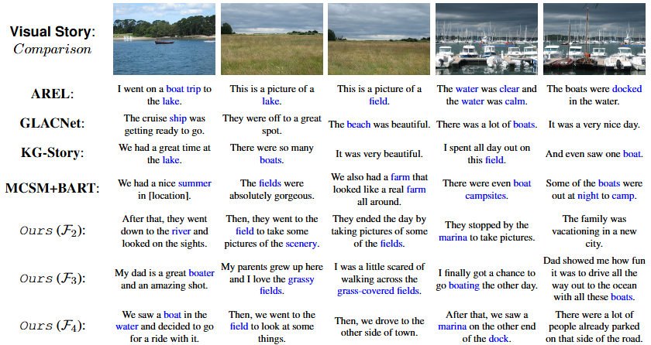
Comparison with others works
11-11-2024
CAN WE STAND AGAINST SOTA ?
Example of visual generated stories by four state-of-the-art Visual Storytelling models, along with the respective generated stories from three variants of our proposed framework. Highlighted blue words visually relate to the input images.

Slide 46
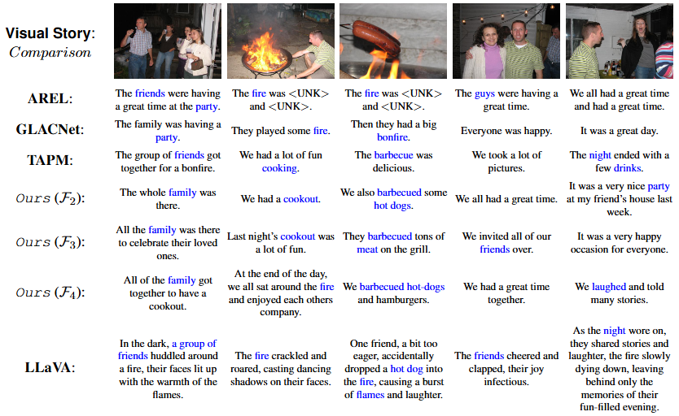
Comparison with others works
11-11-2024
CAN WE STAND AGAINST SOTA ?
Example of visual generated stories by four state-of-the-art Visual Storytelling models, along with the respective generated stories from three variants of our proposed framework. Highlighted blue words visually relate to the input images.

Slide 47
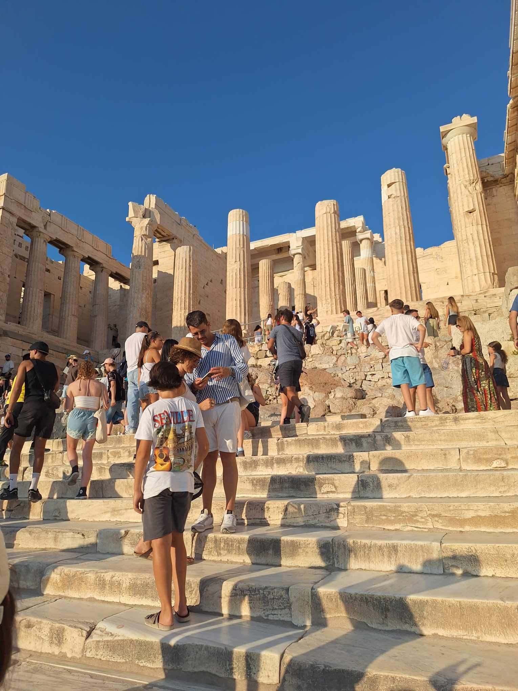




My Story
11-11-2024
A VISIT TO ACROPOLIS
STORY 1: They checked out the museum before leaving. They stood on the steps for a while. The group visited the museum in Greece. As the sun set, they watched down the city. Finally, they ate dinner.
STORY 2: We are just getting to the gate and ready to go in. Oh, my goodness! This is just huge. Look at all the people standing here. Wow, this building is so huge. We better go and get a picture before we leave. The view from our table tonight, awesome.
STORY 3: The tour had begun on time; we could see the group gathering. We gathered in front of the columned building on the outskirts of the city. My friends and I decided to take a trip to a historic site that was under construction. Once inside, I took pictures of some of the more important areas. Finally, we went to dinner at a nearby pub to end our tour.

Slide 48





My Story
11-11-2024
IN THE ELAFONISI BEACH
STORY 1: Two friends decided to go to the beach for the weekend. It was a little chilly, so they wore wetsuits. The two friends were glad they wore sunscreen. They stayed until sundown and then they went home. Their friend joked around before going into the water.
STORY 2: Jason and Steve made a pact to never go in the ocean together. Then Jason realized he'd never gone in the water before, and he jumped in immediately. He grabbed his friend, and they ran as fast as they could away from the waves. They waded into the ocean and had a blast. After they were done, they posed together for a photo to show everyone they'd gone swimming.

Slide 49
THANK YOU VERY MUCH FOR YOUR ATTENTION
QUESTIONS ?

